Slide 1





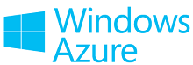
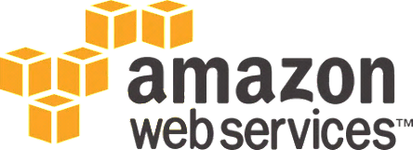

Cloud Technologies and Cloud Platforms
Cloud Concepts, IaaS, PaaS, SaaS, Public Cloud Platforms
SoftUni Team
SaaS
IaaS
Technical Trainers
Software University
PaaS
http://softuni.bg

Slide 2



Table of Contents
What is Cloud Computing?
Cloud Computing Models
IaaS, PaaS, BaaS, SaaS
Public Clouds for Developers
Amazon Web Services (AWS)
Google App Engine (GAE)
Windows Azure
Heroku, AppHarbor

Slide 3

What is Cloud Computing?

Slide 4
What is Virtualization?
Virtualization
Running several virtual machines (virtual computers) inside a single powerful hardware machine
Supported by special software called hypervisor
Use resources more efficiently
E.g. 12 GB physical RAM is shared to 6 virtual machines with 4 GB each (with memory sharing)
Most applications use 1-5% of the CPU
A single shared CPU can serve thousands of users / hundreds of apps
Reduces costs due to better utilization

Slide 5

What is Cloud Computing?
Cloud ≈ combine the computing power and resources of multiple hardware machines
Share the cloud resources between multiple users and apps
Goal: save costs, use resources more efficiently, better service
Cloud computing environment
Suppose we have 20-30 powerful machines
We can run 100-200 virtual machines (VMs)
We can deploy hundreds applications
We can serve millions of users

Slide 6
How the Cloud Works?
In the cloud everyone consumes a portion of the shared computing resources
CPU, memory, storage, IO, networking, etc.
If you business is small, you consume less
If your business is growing, you consume more cloud resources
Pay as you go
Start for free, pay when you grow and need more resources

Slide 7
Cloud Computing – Example
Suppose we have a mail server software
It needs computing resources (CPU, disk operations, networking, etc.) only when sending or receiving emails
It the rest of the time it does nothing (waits)
The mail server on dedicated machine will use less than 1% of its power and resources
You can run 100 mail servers in the cloud on the same hardware
Less hardware, reduced costs, increased quality

Slide 8
Cloud == Computing Resources on Demand
Cloud computing benefits
Computing on demand → pay as you go
Rent a hosting + CPU power + RAM + storage + IO operations + networking + other services (e.g. databases, CDN, analytics, …)
Cloud has better support and reliability
Your data lives in a professional data center
Has 24 x 7 monitoring + backup + support
Reduces costs: rent a piece of a data center instead build you own IT infrastructure / data center

Slide 9
Public / Private / Hybrid Cloud
Public clouds
IT infrastructure, platform or service publicly accessible from Internet (free or paid), e.g. Amazon AWS, Windows Azure
Private clouds
Cloud infrastructure (hardware + software) for internal use only, e.g. for banking / government
Hybrid clouds
Mix of private and public cloud infrastructure and services, e.g. private cloud + backup in Amazon S3

Slide 10
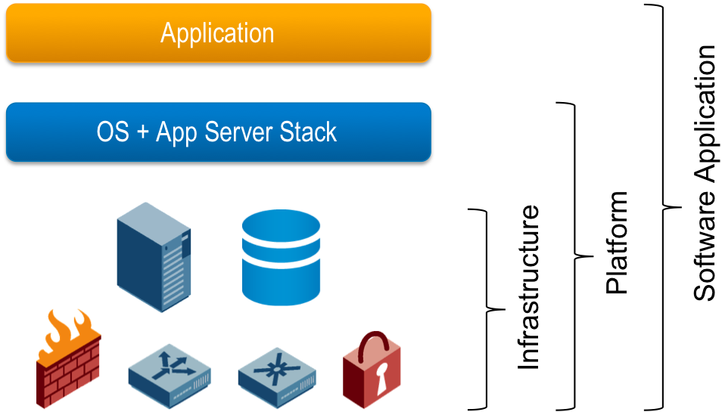
Cloud Computing Models
IaaS, PaaS, BaaS, SaaS

Slide 11
Cloud Computing Models
Infrastructure as a Service (IaaS)
Virtual machines in the cloud on demand
Users install the OS and software they need
Platform as a Service (PaaS)
Platform, services and APIs for developers
E.g. Java + JBoss + JPA + Spring MVC + MongoDB or JavaScript + Node.js + MongoDB + RabbitMQ
Software as a Service (SaaS)
Hosted application on demand (e.g. WordPress site)

Slide 12
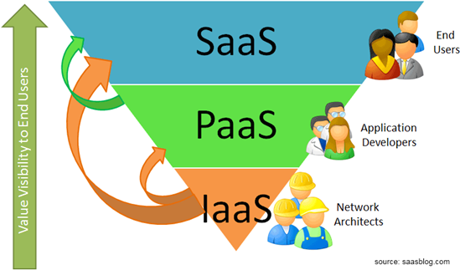
SaaS, PaaS and IaaS

Slide 13





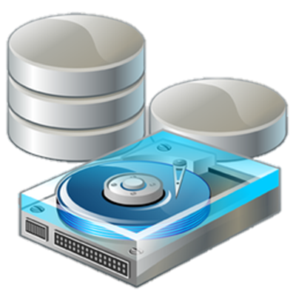
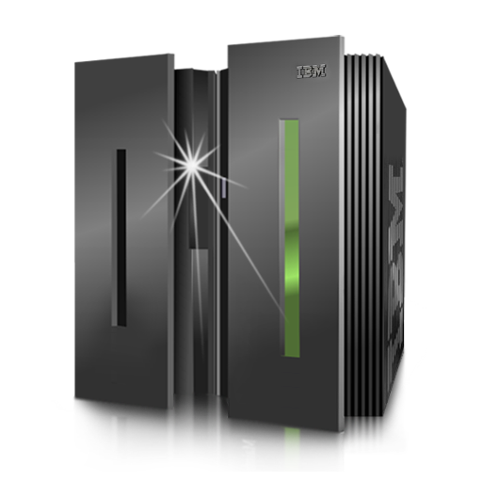

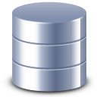
IaaS
Infrastructure as a Service

Slide 14
IaaS (Infrastructure as a Service)
VPS == virtual private server (a virtual machine, VM)
IaaS (Infrastructure as a Service)
IaaS ≈ rent a dynamic virtual machine (VM, VPS) in the cloud
Dynamic VM == you could change your VM resources at runtime
E.g. add more 100 GB HDD storage + 2 GB RAM at runtime
Also known as rent a "cloud server"
IaaS provides an API for managing the cloud infrastructure
E.g. programmable create a new virtual machine / allocate more resources / configure the network / install software / etc.

Slide 15
IaaS Pricing Models
IaaS providers offer different pricing models
Fixed price per month for a cloud server with fixed parameters
Offered by most hosting companies
Pricing based on computing hours for fixed parameters
E.g. Amazon EC2, Rackspace Cloud Servers, Windows Azure Compute
Dynamic pricing per resources used
E.g. $0.024 per GB storage, $0.026 per CPU hour, $0.06 per GB data transfer

Slide 16




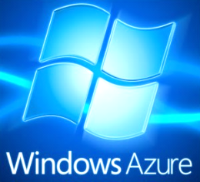
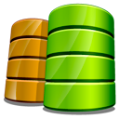
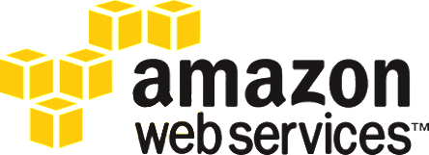
PaaS: Platform as a Service
HTML 5
Node.js
coding
Java
Python
PHP
C#
Ruby
PaaS: Cloud for Developers

Slide 17
PaaS (Platform as a Service)
PaaS ≈ rent a complete development / production platform
Full development stack as a service
E.g. Linux + Python + Django + MongoDB + cron jobs + Nginx load balancer + Gunicorn web server
Back-end technologies
E.g. relational and NoSQL DBs, blob storage, file storage, CDN, …
Business-tier technologies and languages
E.g. Java, Java EE, PHP, Python, Ruby, C#, JS
Frameworks: Django, Rails, Symfony, Spring, JSF, ASP.NET MVC

Slide 18
Typical PaaS Platform
Front-End: HTML5, JavaScript / Mobile Front-Ends
Middle-Tier Languages and Frameworks:
PHP, Java, C#, Python, Ruby, JavaScript, Symfony, Laravel, Zend Framework, JSF, ADF, Sprint MVC, Django, Rails, Sinatra, Play, ASP.NET, ASP.NET MVC, Node.js, Express, …
Computing Nodes (VMs):
Amazon EC2, Azure Compute, App Engine Backends, …
Back-End Technologies:
Relational DBs, NoSQL DBs, Blob Storage, Message Queues, Notifications, CDN, Search, Email, …
Operating Systems: Linux / Windows / other

Slide 19
Typical PaaS Services
Back-Ends on the Cloud
Relational DBs
Managed MySQL, Oracle, PostgreSQL, MS SQL Server, …
Non-relational DBs
Amazon SimpleDB, App Engine Datastore, Azure Tables, Cloudant (CouchDB + MapReduce), MongoDB, Redis, Couchbase, Cassandra
Blob storage / file storage
Amazon S3, Azure Blobs, App Engine Blobstore, Rackspace Cloud Files, Dropbox, pCloud, …

Slide 20
Typical PaaS Services (2)
Middle-Tier on the Cloud
Computing nodes
Amazon EC2, Azure Compute, App Engine Backends, Rackspace Cloud Servers, …
Languages
PHP, Java, Python, Ruby, JavaScript, C#
Frameworks
Symfony, Zend Framework, Laravel, JSF, ADF, Spring MVC, Django, Rails, ASP.NET, ASP.NET MVC, Node.js + Express

Slide 21
Typical PaaS Services (3)
Other PaaS Services and APIs
Queues
Amazon SQS, Google Task Queues, Azure Queues, CloudAMQP
Notification services
Amazon SNS, Windows Push Notifications, Apple Push Notification Service, PubNub
Email services: SendGrid, MailJet, Elastic Email, Amazon SES
CDN (content delivery networks): Amazon CloudFlare, Akamai, …
DNS, load balancing, quality of services, logging, monitoring, analytics, and many others …

Slide 22
Typical PaaS Architecture
The typical cloud architecture is multi-tier, SOA, highly-scalable and highly-available
Each tier hosts different managed services and technologies
Monitoring
Load Balancer
Administration
Computing Node
Computing Node
Computing Node
…
Data-bases
Storage Services
Back-End Services
Other Services

Slide 23
Classical PaaS Stacks
Java + JBoss app server + Java ServerFaces + JBoss Rich Faces + Java Persistence API + Oracle database
Python + Django + MongoDB + Linux cron jobs + Nginx load balancer + Gunicorn web server
.NET Framework + C# + ASP.NET + WCF + SQL Server + Nginx load balancer + IIS web server
PHP + Laravel + MongoDB + Nginx load balancer + Apache web server
JavaScript + Node.js + MongoDB + RabbitMQ
Ruby + Ruby on Rails + MySQL + Sphinx + Memcache + Unicorn server

Slide 24
Proprietary PaaS Stacks
Amazon Web Services (AWS)
PHP + Amazon EC2 + Linux + Apache + Amazon DynamoDB + Amazon S3 + Amazon Block Store (EBS)
Java + Amazon EC2 + Tomcat + Spring + Hibernate + JavaServer Faces (JSF) + Amazon RDS (Oracle)
Windows Azure
C# + Windows Azure Compute + WCF + ASP.NET MVC + Azure Tables + SQL Azure + Azure Blobs + Azure CDN
Google App Engine (GAE)
Java + App Engine Backends + App Engine Datastore + JPA + Google Cloud Storage + JSF + Memcache

Slide 25
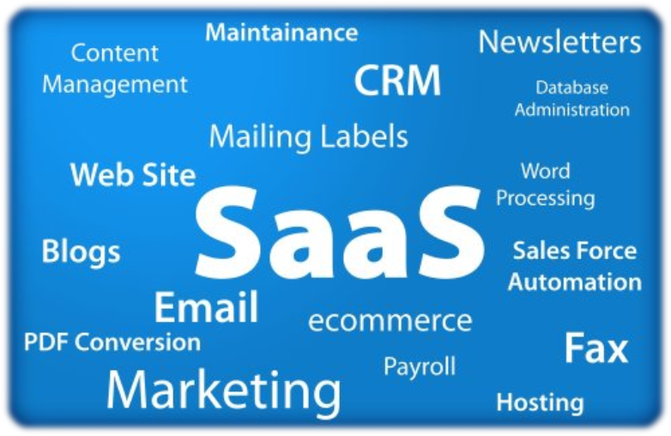
SaaS
Software as a Service

Slide 26
SaaS (Software as a Service)
SaaS ≈ rent an application in the cloud
Fully managed application → just login and use it
Examples of public SaaS services
WordPress.com – managed hosting of WordPress sites
MailChimp – managed email marketing platform
Basecamp – web-based project management and team collaboration
Salesforce.com – managed CRM platform on demand
Adobe Creative Cloud – cloud for designers and creative artists
Autodesk 360 – cloud for building architects / AutoCAD users

Slide 27
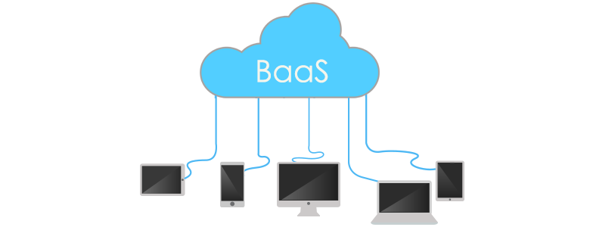
BaaS
Back-End as a Service

Slide 28
BaaS (Backend as a Service)
BaaS ≈ rent a backend in the cloud
Also known as mBaaS (Mobile Backend as a Service)
Fully managed backend for your mobile or SPA application
Typically provides database + REST API + storage services + notifications
Register, create your data model and use it through REST / other API
Examples of public BaaS clouds: Parse.com, BaasBox, Kinvey, Kumulos
Parse.com – simple and powerful BaaS from Facebook
Provides NoSQL database (object and queries), users, roles, permissions, file storage, push notifications, analytics, GEO points, etc.

Slide 29



Cloud Development
Challenges for Cloud Developers

Slide 30
What is Cloud Development?
Cloud software development
Design and develop an application for the cloud
Especially for the public PaaS cloud platforms
Typical steps in cloud software development
Choose a development stack of technologies
Choose a public cloud platform + services
Design the application for the cloud
Develop the application using the cloud APIs
Deploy, run and monitor the application in the cloud

Slide 31
What is a Public Cloud?
Public clouds
Provide computing resources on demand
Publicly in Internet, for everyone
Paid or free of charge (to some limit)
Could be IaaS, PaaS, SaaS or mix of them
Examples of public clouds
Amazon AWS, Google App Engine (GAE), Windows Azure, Rackspace, Heroku, AppHarbor, Force.com AppForce, Joyent, dotCloud, Engineyard, OpenShift, CloudBees, CloudSwing, Cloud Foundry, Oracle Public Cloud, Salesforce, Parse.com, WordPress.com, …
Public Clouds

Slide 32
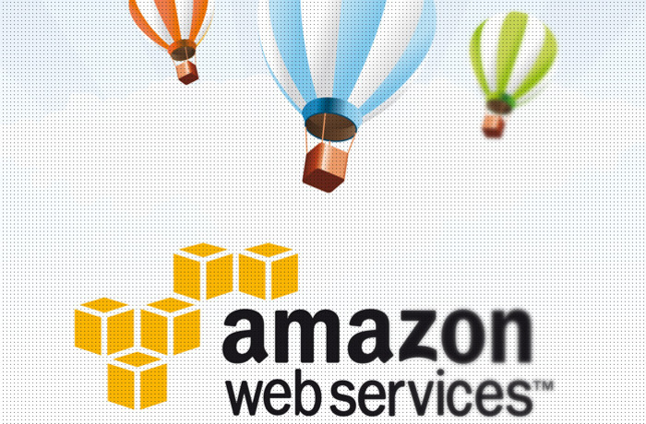
Amazon Web Services (AWS)
The Largest Public Cloud Platform

Slide 33
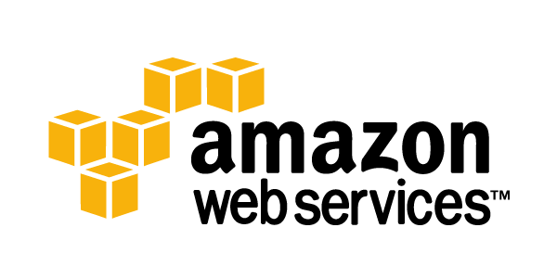
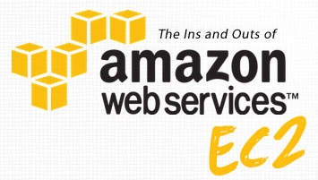
Amazon Web Services
Amazon Web Services (AWS)
The pioneer of the public clouds
Provides cloud platform and services from 2002
Provides IaaS and PaaS on demand
Amazon Elastic Compute Cloud (Amazon EC2)
Virtual machines on demand (cloud VPS)
Runs Windows / Linux / other OS
Multiple locations: US, EU, Japan, Brazil, …
http://aws.amazon.com/ec2/

Slide 34
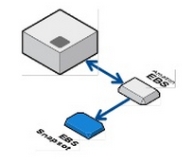
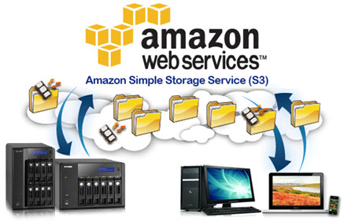
Amazon Web Services (2)
Amazon Elastic Block Store (Amazon EBS)
Virtual hard disk (HDD) volumes
Used with the EC2 to keep the OS file system
http://aws.amazon.com/ebs/
Amazon Simple Storage Service (Amazon S3)
Hosting binary data (files, images, videos, etc.)
Accessible through the Web
With or without authentication
http://aws.amazon.com/s3/

Slide 35
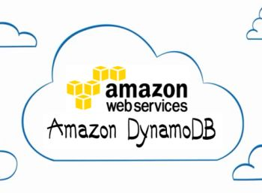
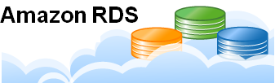
Amazon Web Services (3)
Amazon DynamoDB / SimpleDB
Managed NoSQL cloud database
Highly scalable, fault-tolerant
DynamoDB is newer and faster than SimpleDB
http://aws.amazon.com/dynamodb/
Amazon Relational Database Service (RDS)
Managed MySQL and Oracle databases
Scalability, automated backup, replication
http://aws.amazon.com/rds/

Slide 36

Amazon Web Services (4)
Other AWS services
Amazon SQS (message queue)
Amazon CloudFront (content delivery network)
Amazon ElastiCache (caching)
Amazon Route 53 (cloud DNS)
Amazon SES (email)
Pricing
On-demand pricing (per hour / per GB)
Has 1-year free trial (credit card required)

Slide 37
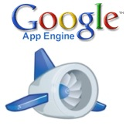
Google App Engine (GAE)
The Google's Public Cloud Platform

Slide 38
Google App Engine
Google App Engine (GAE)
PaaS public cloud for Java, Python and PHP
Infrastructure similar to the one driving GMail and Google Docs operated by Google
https://cloud.google.com/appengine/
Provides CPU / bandwidth / storage capable to serve 5 000 000 page views / month
App Engine has a completely free trial version
Instant registration with SMS confirmation (no credit card)

Slide 39
Google App Engine Services
App Engine instances
Computing units that host the applications
Fully managed sandboxes (they are not VMs!)
Provide CPU + RAM + storage + language runtime
App Engine Console: https://appengine.google.com
App Engine back-ends
Like the App Engine instances
But provides higher computing resources
Used for background processing

Slide 40
Google App Engine Services (2)
App Engine datastores
Provide NoSQL schemaless object database
Supports transacts and a query-engine (GQL)
High-replication datastore (HRD)
Master-slave datastore (faster but less-reliable)
Cloud SQL
Managed MySQL in the App Engine cloud
Blobstore / Cloud Storage
Store files / blobs, has with ACL and REST API

Slide 41
Google App Engine Services (3)
MapReduce API
Highly-scalable parallel computing API for heavy computing tasks (based on Hadoop)
Channel API
Push notifications for JavaScript applications
Task Queues
Services for execution of background work
Memcache
Distributed in-memory data cache

Slide 42
App Engine for Java & Python
Google App Engine for Java
Java 6 in a sandbox environment + Eclipse plugin (for deployment)
Java Web apps (WARs) / Servlets / JSPs + GWT
Persistence with JPA and JDO in the datastore
Google App Engine for Python
Python 2.5 in a sandbox + Django support
Google App Engine for PHP
PHP 5.5 + Cloud SQL (managed MySQL)

Slide 43
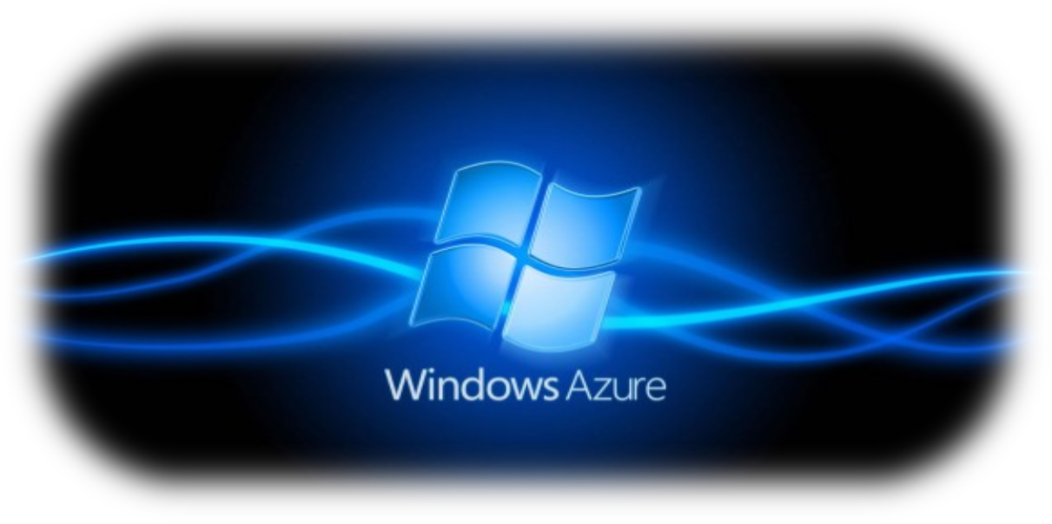
Windows Azure
Microsoft's Public Cloud Platform

Slide 44
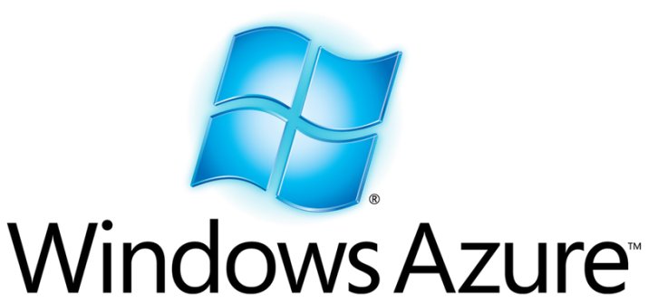
Windows Azure
Microsoft Windows Azure
Fast-growing public cloud from Microsoft
Provides rich PaaS platform
Mainly for .NET developers
Provides also Java, PHP, Python, and Node.js APIs
Databases, storage, mobile back-ends, CDN, …
Provides IaaS cloud (Windows VMs)
No free version, only 1 month trial (credit card required)

Slide 45
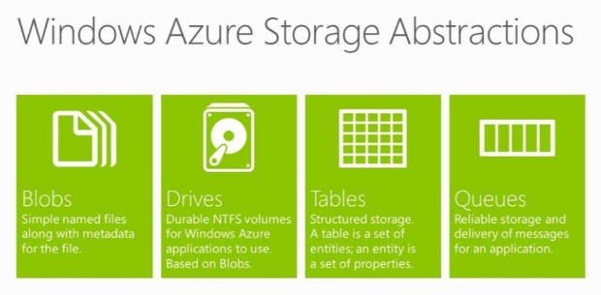
Windows Azure Services
Azure Compute – VMs in the Azure cloud
Storage services
SQL Database – cloud version of SQL Server
Azure Table Storage (NoSQL database)
Azure Queue Storage – message queue services
Azure Blobs / Drives – blob / file storage, NTFS volumes
Azure CDN – content delivery network
Azure Caching – distributed, in-memory, application cache

Slide 46

Heroku
Rich and Powerful Cloud Platform

Slide 47
Heroku
Heroku is a leading public PaaS platform
Supports very broad stack of technologies
Everything except C# .NET (officially)
Development stacks
Java + Spring + Hibernate + PostgreSQL / MySQL / MongoDB + Memcache + Tomcat / Jetty
Ruby + Rails + MongoDB / MySQL + Memcache
Python + Django + Memcache + PostgreSQL
JavaScript + Node.js + Express + MySQL / MongoDB
PHP + MySQL / MongoDB

Slide 48
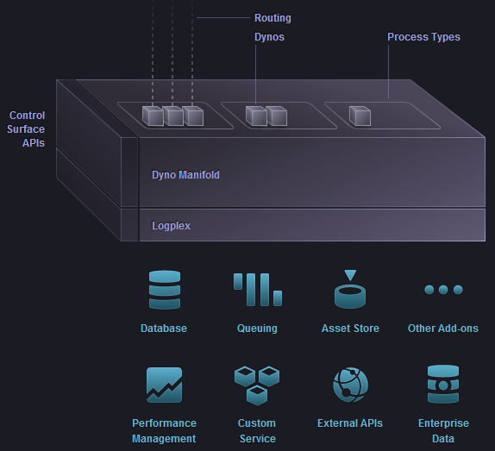
The Heroku Platform
Routing
HTTP load balancers
Dynos – managed workers
Web / Worker / Cron
Back-ends systems
DB: MySQL / PostgreSQL
Add-ons: MongoDB, Redis
Auto-scaling technology
Logging and monitoring (Logplex)
Git-based deployment

Slide 49
Heroku Add-Ons
Large set of add-ons for developers
Airbrake, Amazon RDS, Apigee for Facebook, Apigee for Twitter, Appoxy SimpleWorker, Blitz, Chargify, ClearDB MySQL, Cloudant (CouchDB + MapReduce), CloudMailin, Cron, Custom Domains, DbInsights, Deploy Hooks, DocRaptor, DynectSMB, Exceptional, Flying Sphinx, Heroku PG Backups, Heroku PostgreSQL, Heroku Scheduler, Heroku Shared PostgreSQL, Hoptoad, IndexTank, IronMQ

Slide 50
Heroku Add-Ons (2)
Large set of add-ons for developers
IronWorker, JustOneDB, Loggly, Mailgun, Memcache, MongoHQ, MongoLab, Moonshado SMS, Neo4j, New Relic, Panda Stream, Progstr Logger, PubNub, Pusher, RabbitMQ, Ranger, Redis To Go, RESTful Metrics, RhoConnect, Searchify IndexTank, Sendgrid, SimpleGeo, SSL, Stackmob, StatsMix, StatsMix Heroku, Integration Tutorial, StillAlive, Tddium, Treasure Data Hadoop, Tronprint, Websolr, Xeround, Zencoder, Zerigo DNS, …

Slide 51
More about Heroku
Heroku
Runs millions of applications
Owned by Salesforce.com
Founded in 2007, fast growing and mature
Heroku has a completely free limited version
750 computing hours / month
100 MB storage + 5 MB database
Credit card not required

Slide 52
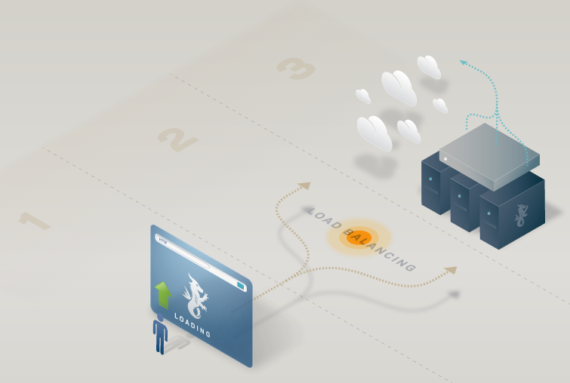

AppHarbor
The Leading Non-Microsoft .NET Cloud

Slide 53
AppHarbor
AppHarbor – public cloud platform for .NET apps
Supports a classical .NET development stack
C#, .NET Framework, ASP.NET (Web Forms and MVC), WCF, WWF, Entity Framework, …
Deployment through Git / SVN / TFS
Automated build process (compile + unit tests)
Build-in load balancing
Built on top of Amazon AWS infrastructure
Rich set of add-on services

Slide 54


AppHarbor: Add-On Services
Airbrake (error logging)
Blitz (performance monitoring)
CloudAMQP (RabbitMQ)
Cloudant (CouchDB)
CloudMailin (incoming email)
Dedicated SQL Server
JustOneDB (NoSLQ database)
Logentries (log management)
Mailgun (email send / receive)

Slide 55


AppHarbor: Add-On Services (2)
Memcacher (in-memory caching)
MongoHQ (managed MongoDB)
MongoLab (managed MongoDB)
MySQL (shared MySQL DB)
RavenHQ (NoSQL database)
Redis To Go (key-value store)
SendGrid (email delivery)
StillAlive (app monitoring)
Shared SQL Server (managed instance)

Slide 56


Choosing a Public Cloud
Public
Clouds
Guidelines for Choosing a Public Cloud

Slide 57
Choosing a Public Cloud
How to choose a public cloud for your app?
.NET → Azure / Amazon / AppHarbor
Java → Google App Engine / Heroku / Oracle Public Cloud / other
PHP → App Fog / Engineyard / Heroku / App Engine / other
Ruby → Heroku / Engineyard / OpenShift
Python → App Engine / Heroku / OpenShift
Always consider using IaaS clouds
And build your own platform on top of them

Slide 58









Cloud Technologies and Cloud Platforms
https://softuni.bg/courses/web-services-and-cloud/

Slide 59
License
This course (slides, examples, demos, videos, homework, etc.) is licensed under the "Creative Commons Attribution-NonCommercial-ShareAlike 4.0 International" license
Attribution: this work may contain portions from
"Web Services and Cloud" course by Telerik Academy under CC-BY-NC-SA license

Slide 60





Free Trainings @ Software University
Software University Foundation – softuni.org
Software University – High-Quality Education, Profession and Job for Software Developers
softuni.bg
Software University @ Facebook
facebook.com/SoftwareUniversity
Software University @ YouTube
youtube.com/SoftwareUniversity
Software University Forums – forum.softuni.bg

